Slide 1
Benchmarking SQL and NoSQL Database Systems; Baking a New Enchilada
Kelsey Krantz, Thais Del Rosario, Nathan Rowley, Eric Stadelman

Slide 2
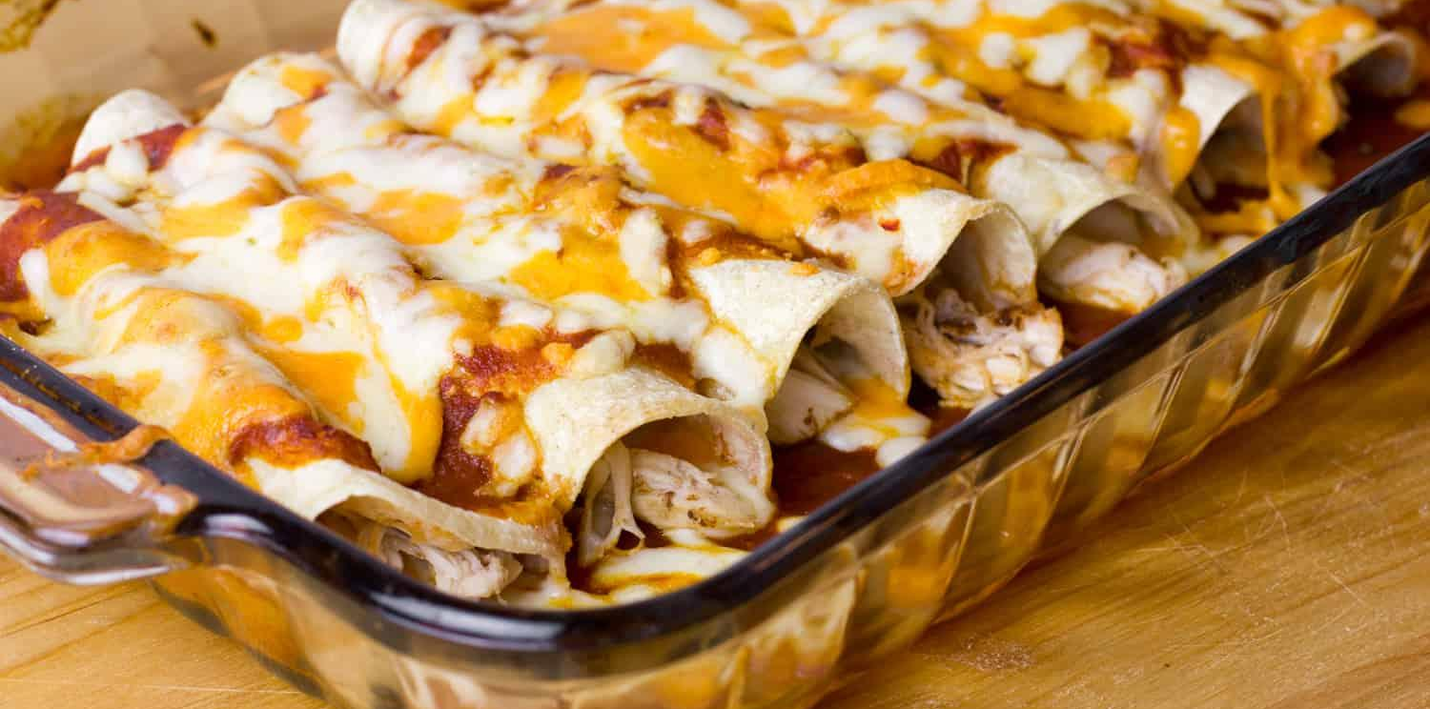
Enchilada
Environmental Chemistry through Intelligent Atmospheric Data Analysis.
Analysis of atmospheric data - airborne aerosol particles
Clustering of mass spectra
Capable of importing data from a variety of formats
Measurement of air composition, relevant to air pollution
Notes:
Who is Deborah
This tool is widely used in research beyond Carleton

Slide 3
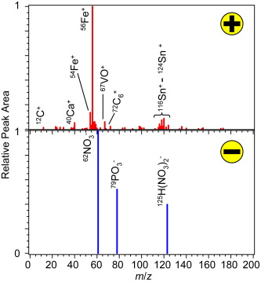
Enchilada - Analytical Tools
Grouping mass spectra by querying databases or by clustering
Generating temporal profiles of various particle characteristics
Determining traditional aerosol metrics such as mass or number concentration and size distributions for a time period or as a function of time
Visualization of data

Slide 4
Goals
Update Enchilada to modern standards
Update to modern version of Java
Make the installation process easier
Ensure it runs smoothly on current versions of OS
Make a new version of the Enchilada application
Find the best database system for Enchilada
SQL Server was slow and confusing to install
Windows only
NoSQL systems were not popular when Enchilada was first created

Slide 5

A Fresher Enchilada
Enchilada is old code (Java 7)
We updated it to Java 11
It could no longer be built into an application
We reconfigured it to build using Maven
This improves maintainability
Image credit: https://maven.apache.org/

Slide 6
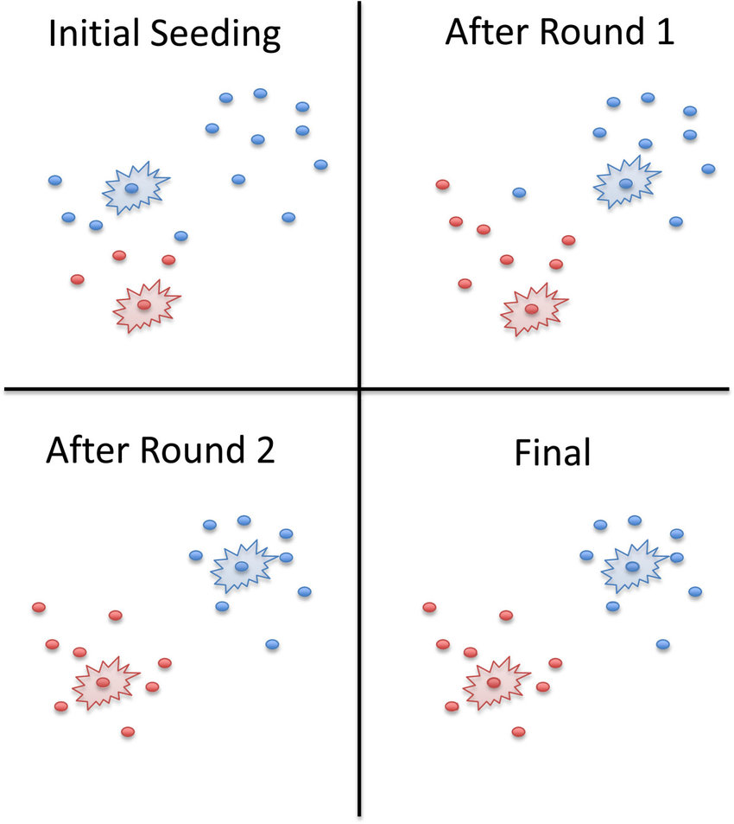
How to Benchmark Databases for Enchilada
K-Means clustering
Simple dataload
Holistic Clustering
Create
Read
Update
Delete

Slide 7
The Database Systems We Tested
Relational systems
Microsoft’s SQL Server
PostgreSQL
NoSQL systems
Cassandra
Influx
MongoDB

Slide 8

Relational Database - SQL Server
Enchilada utilizes Microsoft SQL Server
Built on top of SQL (Structured Query Language)
Structured with Tables (Rows and Columns) and relations between them
Difficult to set up
Not open source

Slide 9
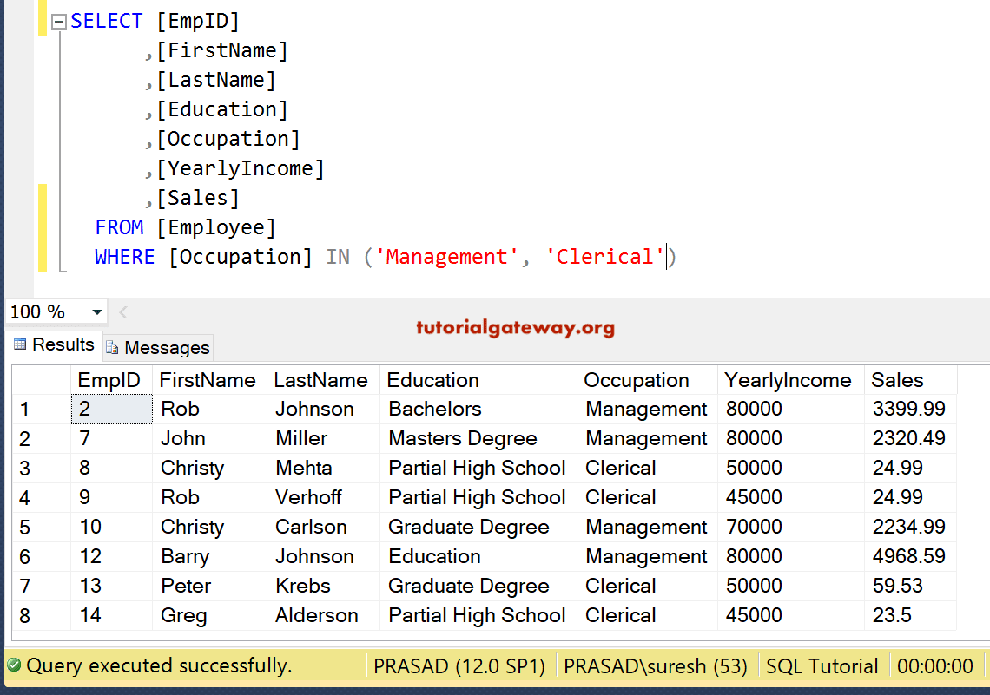
Query
Notes:
SELECT (What info from the results to get back), FROM (Table), WHERE (Filter) - explain each component

Slide 10
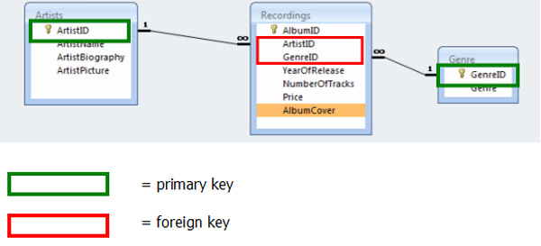
Relational Database Structure
Data stored in a set of relations between tables.
Attributes in a column can refer directly to data in another table.
Primary & Foreign keys
Minimized redundancy
Notes:
Relating/Connecting

Slide 11
Relational Systems - ACID
Strong guarantee of ACID properties
Atomicity
Consistency
Isolation
Durability
These properties ensure the robustness of the data
Notes:
Atomicity is an all-or-none proposition; Consistency guarantees that a transaction never leaves your database in a half-finished state; Isolation keeps transactions separated from each other until they’re finished; Durability guarantees that the database will keep track of pending changes in such a way that the server can recover from an abnormal termination.

Slide 12

Relational Database - PostgreSQL
Extremely similar to SQL Server
Easy to set up
Open source
Cross-platform
Notes:
Another relational database management system
Additionally, the development team also considered MySQL as another relational database system for Enchilada
Why do we care about it being open source (no money/licensing) /cross-platform?

Slide 13

Column Family - Cassandra
Created at facebook for the inbox search feature
Cassandra Query Language - structured like SQL to ease the transition from RDBMS
Key Features
Fast writes and reads
Short learning curve
Distributed
Scalable
Fault tolerant
Image Credit : https://commons.wikimedia.org/
Notes:
Also called wide column store, other example is google big table
“It is a tuple (pair) that consists of a key-value pair, where the key is mapped to a value that is a set of columns. In analogy with relational databases, a column family is as a "table", each key-value pair being a "row". Each column is a tuple (triplet) consisting of a column name, a value, and a timestamp. In a relational database table, this data would be grouped together within a table with other non-related data.”
Asynchronous

Slide 14
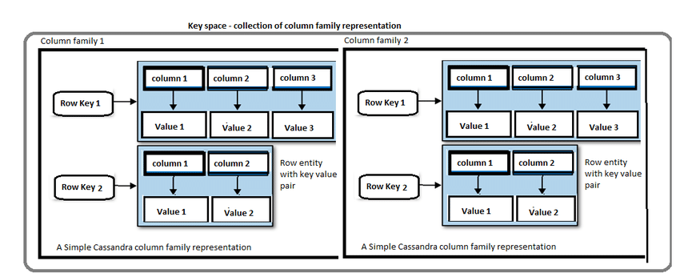
Cassandra- Data Model
Column Families called “tables” are queried for specific rows on Partition Keys and Primary Keys
Only stores columns present in that row

Slide 15
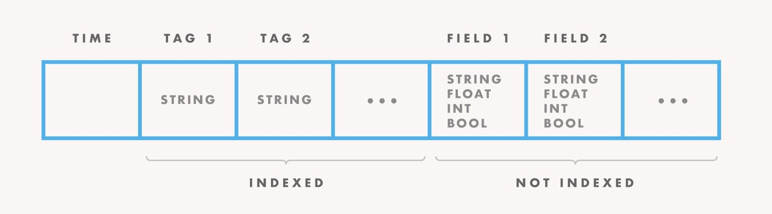

Time Series Database - InfluxDB
Optimized for time-stamped data or time-series data
Similar feel to a traditional relational database
Problems: read/write I/O, data loss, deletion

Slide 16

Document Store - MongoDB
Widely-used NoSQL database
Generally regarded as fast and reliable
More flexible than relational databases
Extremely easy to install
Image credit: https://www.mongodb.com/

Slide 17
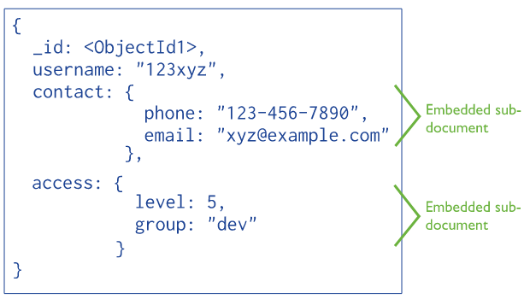
Data Model
Data stored as documents
Flexible structure
No concept of columns.
Almost no ACID guarantees by default
Support for stricter ACID guarantees
Image credit: https://docs.mongodb.com/manual/core/data-modeling-introduction/

Slide 18
Benchmark Design Challenges
Database configuration
Consistent hardware
Systematic vs. Practical
Generalizing results
Lawsuits!

Slide 19
Our Answers
Database configuration: Configure as little as possible
Consistent hardware: Use consistent hardware
Systematic vs. Practical: Use a practical test
Generalizing results: Benchmarking for a specific context
Lawsuits: None so far!

Slide 20
Running the Benchmarks
Installing and configuring each DB on one machine
Create a fair environment
Background processes
Limited hardware
Two different approaches
Isolation test
Test with more background activity

Slide 21
Results
Isolation : Data Load
Isolation: Clustering
Simultaneous : Data Load
Simultaneous : Clustering
DBMS | Time(Mins)
SQL Server | 2.1573
PostgreSQL | 1.3506
Cassandra | 0.6640
InfluxDB | 3.3387
MongoDB | 1.0857
DBMS | Time(Mins)
SQL Server | 2.8886
PostgreSQL | 1.6305
Cassandra | 167.7348
InfluxDB | 59.0143
MongoDB | 2.2262
DBMS | Time(Mins)
SQL Server | 2.2291
PostgreSQL | 1.3464
Cassandra | 1.1538
InfluxDB | 3.2683
MongoDB | 0.9999
DBMS | Time(Mins)
SQL Server | 2.9100
PostgreSQL | 2.0661
Cassandra | 167.9599
InfluxDB | 79.9016
MongoDB | 2.8452

Slide 22
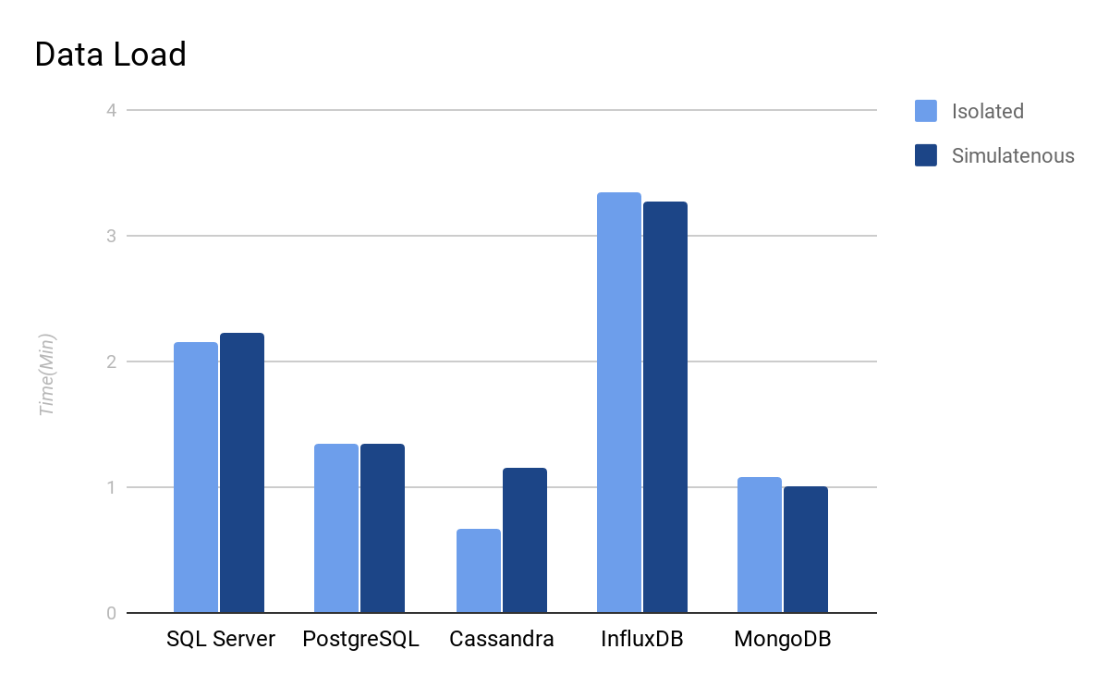
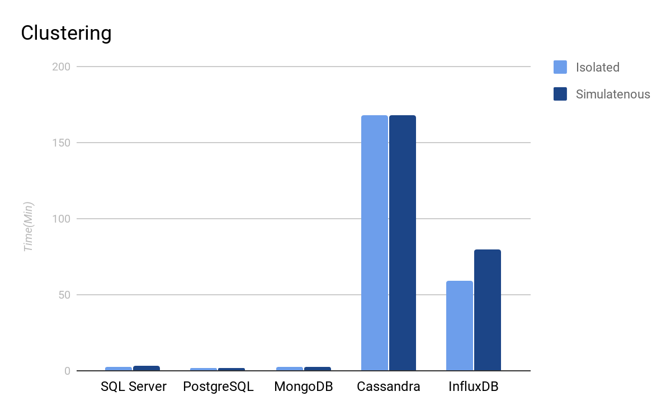
Results

Slide 23
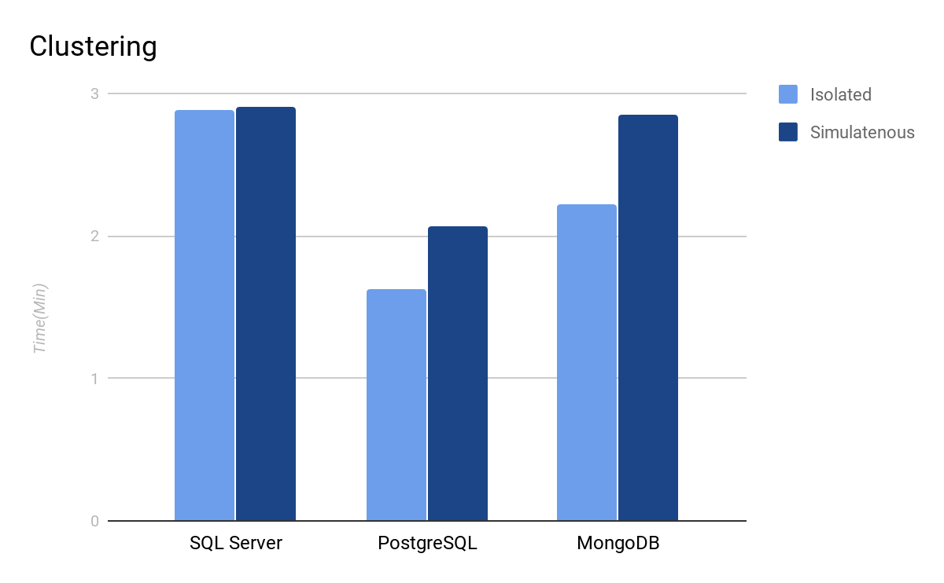
Conclusion
Postgres is the fastest for Enchilada overall
MongoDB was the fastest NoSQL
NoSQL systems are scalable
Why were Cassandra and InfluxDB so slow?
Tests were designed based on the existing Enchilada code
Not optimized per system
Notes:
Mongo has low overhead (few acid guarantees) and automatically indexes on the “_id” field

Slide 24
Future directions
Implementing a new system (MongoDB vs PostgreSQL)
Revisiting tests
New application version
Notes:
Why are we revisiting tests? Some of them weren’t passing, might want to make sure the whole system is working as it isn’t as of the latest Maven rebuild. (e.g. check and update drivers, etc.)

Slide 25
Thank You!
Thanks to Dave Musicant, our advisor, and Deborah Gross.

